Slide 1
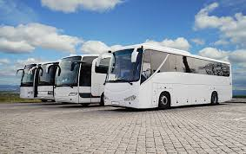
Bus Ticketing Management System

Slide 2
Introduction
For managing ticket in a scientific and systematic way
It allows to the passenger to book ticket from home and office
It allows the passenger to signup and register, and give access to the site
It will be faster, time saver, efficient and effective
It will be web based software

Slide 3
Problem statement
Increasing in the number of business creates trouble to manage bus company’s daily routines and schedules
Ticket counter is overloaded hard to manage ticket manually
Difficult to the passenger
Hard to handling by traditional system
It is difficult to analyze the data of the system
Unable to manage data for long period of time
It is time consuming

Slide 4
Background of the project
it is an important document to create an overview of the project activities and goals.
To book the ticket, first passenger need to login and only then able to perform the operation.
This application is solely for the booking department staff and passenger
The admin maintain the list of buses, their routes
It stores all the data for long period of time for business analysis
It can maintain the records of the buses along with details of the customer

Slide 5
Aims and Objectives
Aims
Customers can enjoy the advantage of booking tickets of any bus from anywhere
For providing the basic facilities
For expanding the business
To involve more passengers
For making availability of bus ticket to the customer at low cost
To act as the easiest way for anyone to book ticket of any bus company

Slide 6
Objectives
providing the features of CRUD functions
All manual work is converted into computerized, load of employee decrease
Proper training to the employee
For meeting the all business requirements
Implementation and testing should be done
Project should be deployed in time
User-friendly, cost effective, easy to use, secure system
it should be error free

Slide 7
Features of the project
Project planning, scheduling
Team collaboration
Reporting
Project budgeting
Allows the customer to book ticket in systematic manner
Allows register individual account, login, book ticket, cancel ticket, etc
Allows billing
Stores data related with bus and passenger

Slide 8
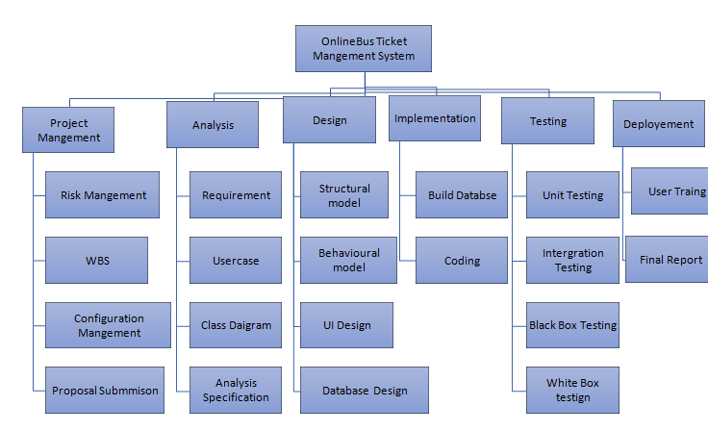
WBS

Slide 9
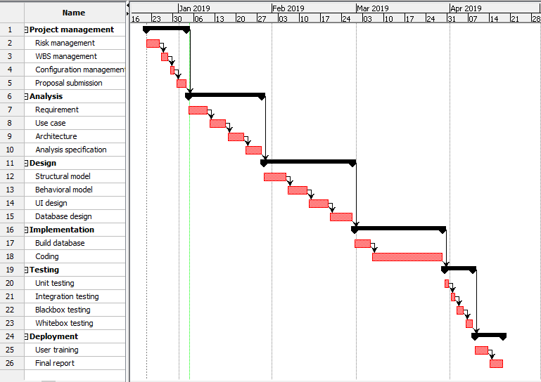
Gantt Chart

Slide 10
Methodology with justification and why
Water fall methodology is used.
It is simple to understand and use
It has different phase

Slide 11
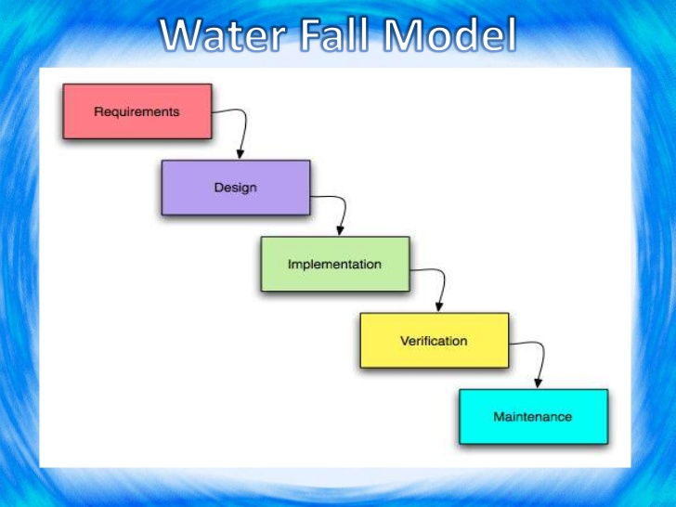

Slide 12
Justification and reasons:-
It is suitable for small projects
Easy to manage
Requirements and analysis are well understood
Easy to understand
Milestone of software development are clear
Well documented

Slide 13
Architecture with diagram
For our project Model View Controller (MVC) design architecture is used
It is a software design pattern
It is not completed design and cannot be transferred directly into machine code
Model means data, view means user interface and controller means process
It is used to develop modern user interface of the system
The diagram for MVC architecture is:-

Slide 14
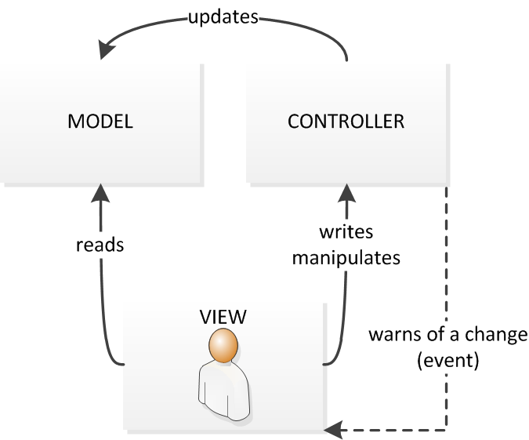
MVC diagram

Slide 15
Risk management
It is the process of identifying, evaluating and prioritizing the possible risk
To monitor, to minimize and to control the impact of that risk is called risk management

Slide 16
Risk Likelihood values are shown as follows
Likelihood
Value
Low
1
Medium
2
High
3
Risk Consequence values are shown below
Consequence
Value
Very low
1
Low
2
Medium
3
High
4
Very High
5

Slide 17
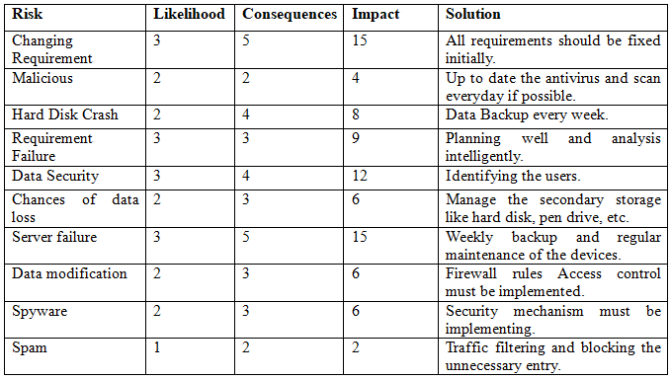

Slide 18
Configuration management
For establishing and maintaining consistency of products performance, functional and physical attributes
It also helps in controlling and tracking the changes in the software

Slide 19
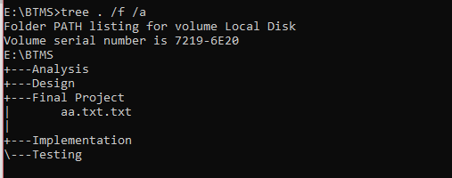

Slide 20
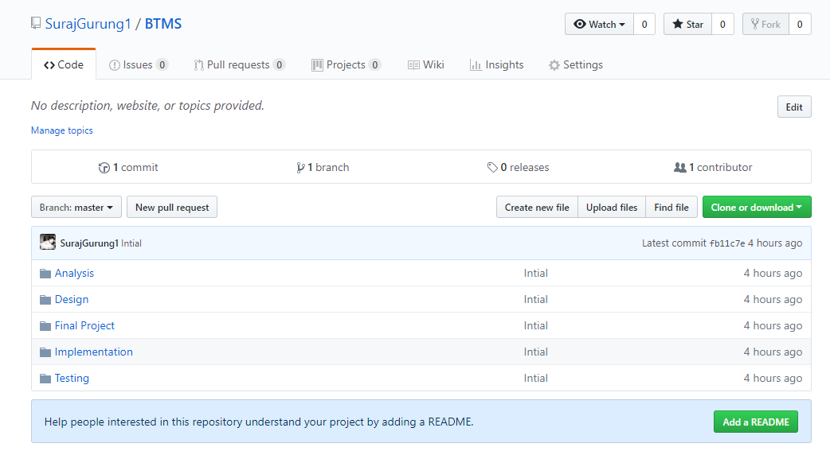

Slide 21
Design
it is a software design pattern.
It is a general, reusable solution to a company
It is not a finished design that can be transformed directly into source or machine code

Slide 22
Types of design
There are mainly three types of design pattern:-
Structural design pattern
it is a pattern used for organizing different classes and objects to form larger structures
Creational design pattern
it is a pattern which is all about class instantiation or object creation
Behavioral
it is a pattern use for identifying common communication patterns between objects

Slide 23
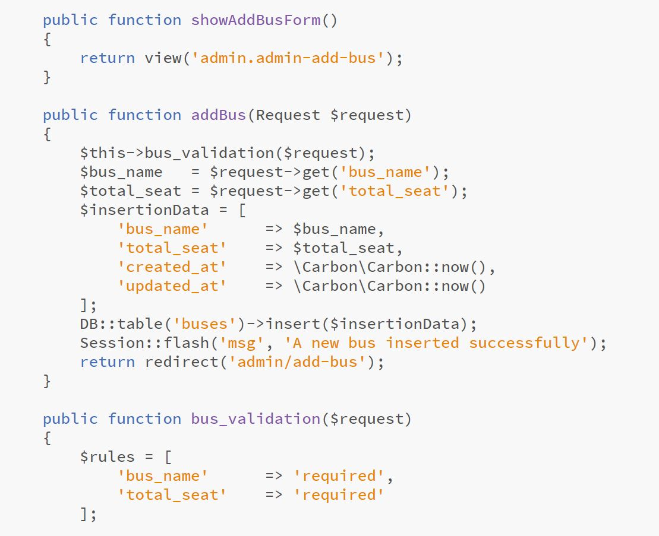
Coding and UI design

Slide 24
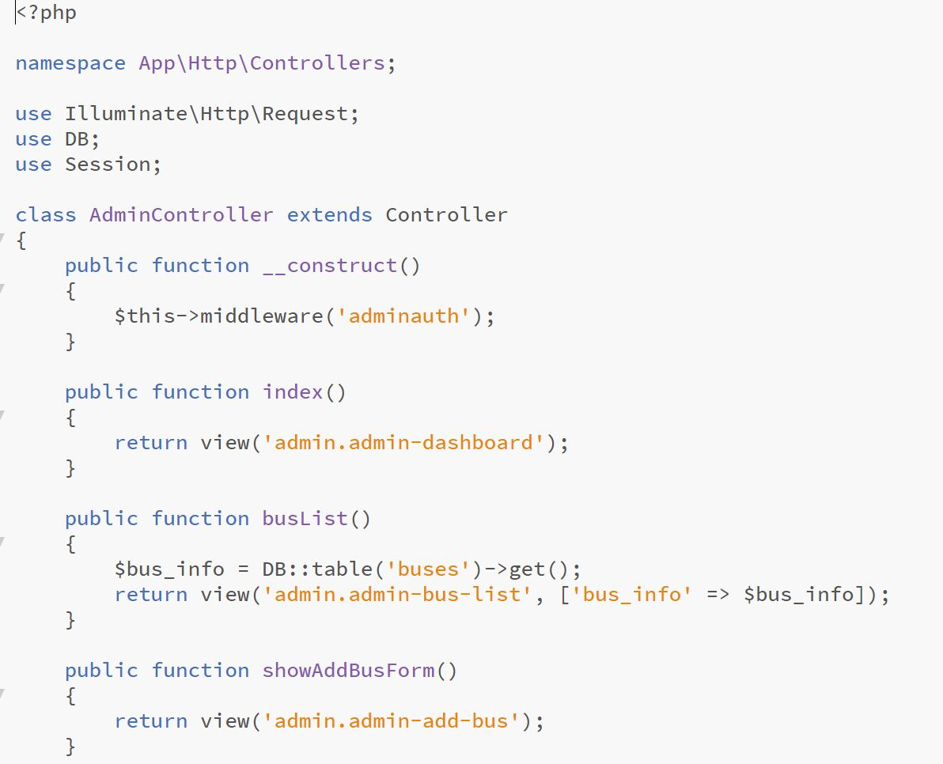

Slide 25
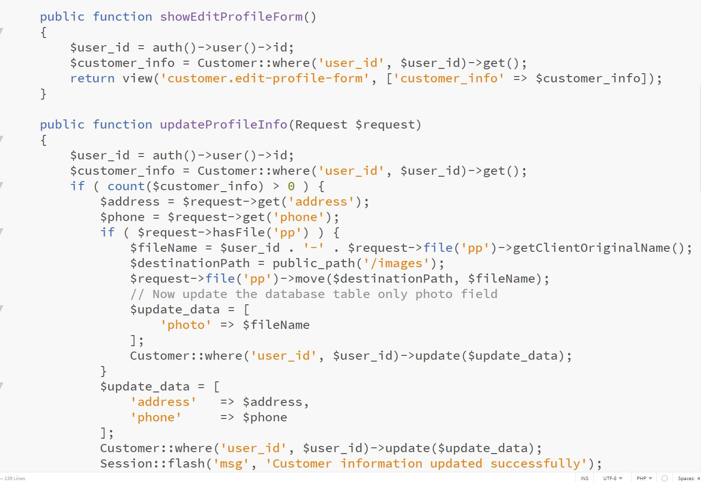

Slide 26
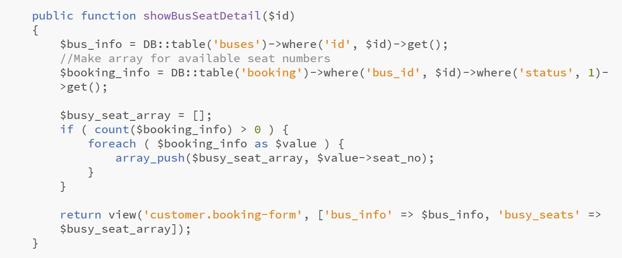

Slide 27
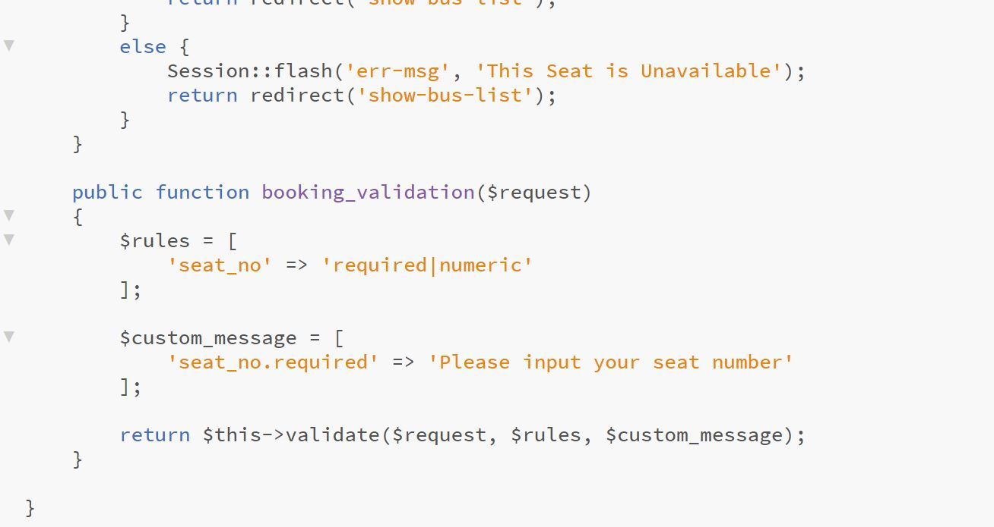

Slide 28
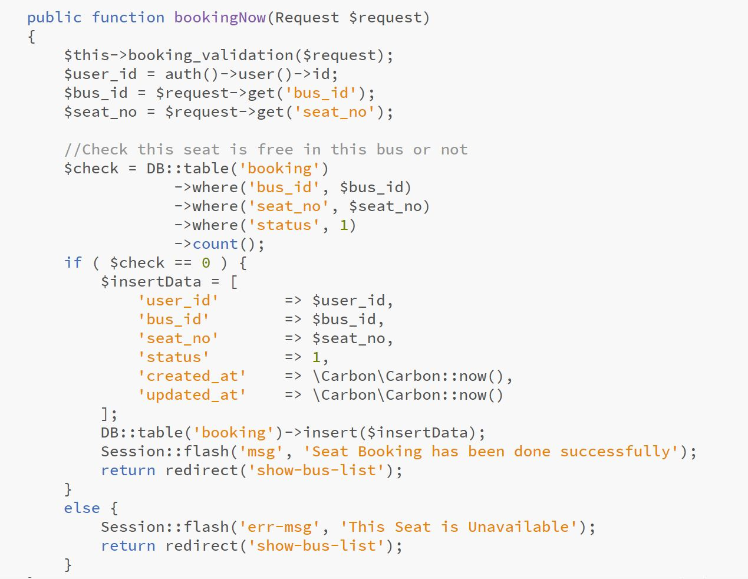

Slide 29
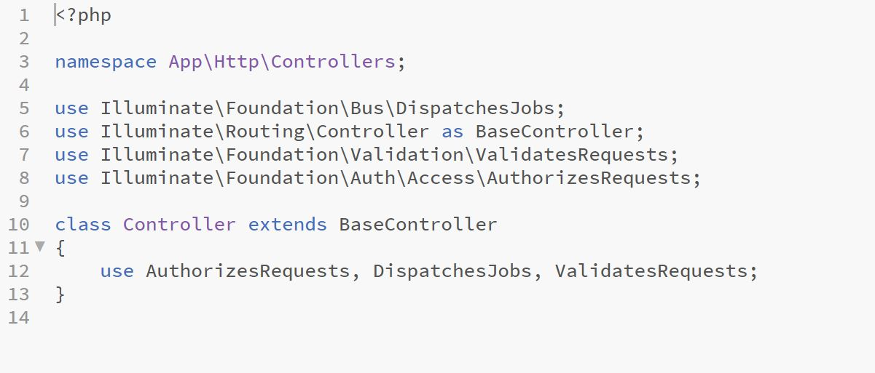

Slide 30
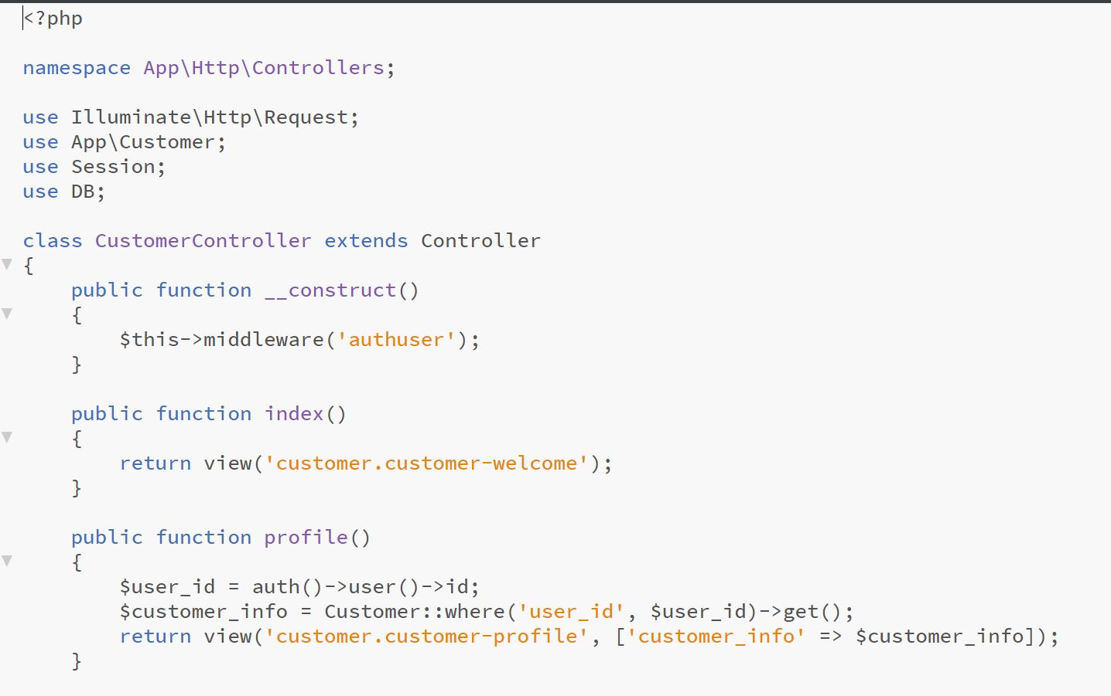

Slide 31
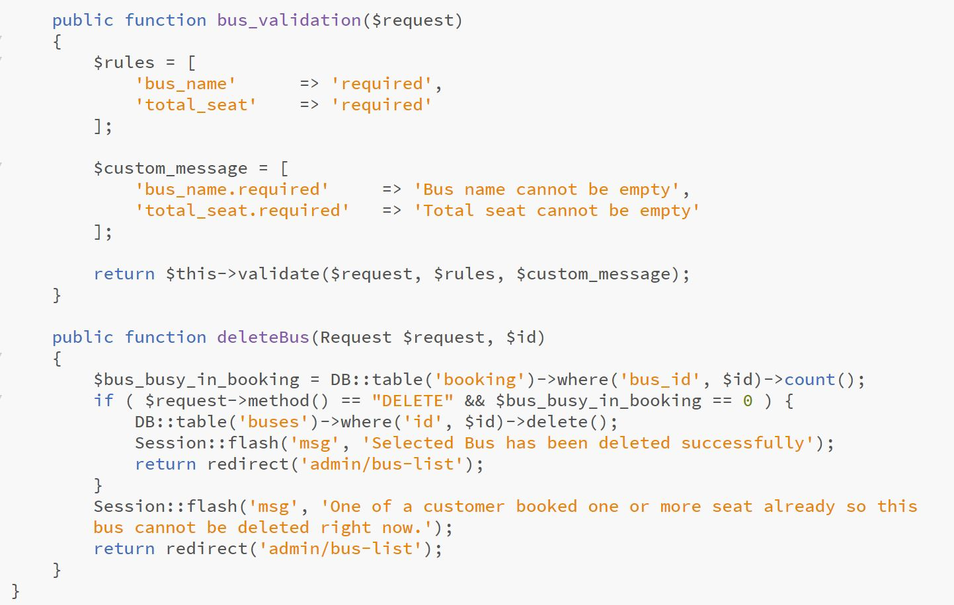

Slide 32
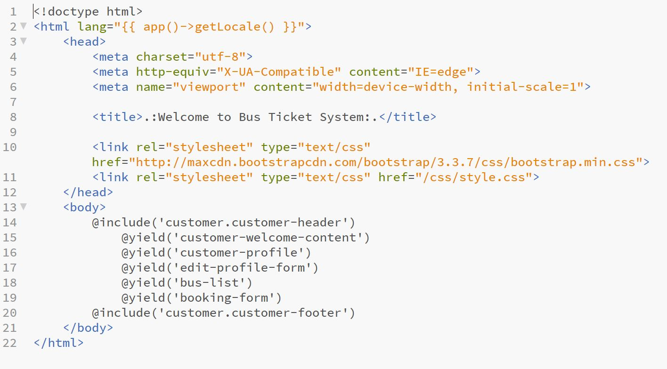

Slide 33
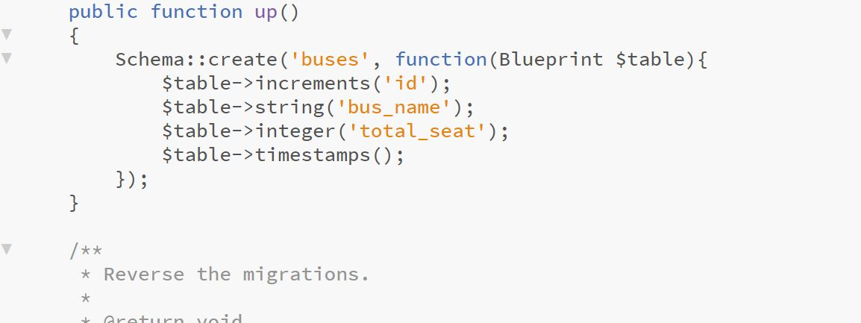

Slide 34
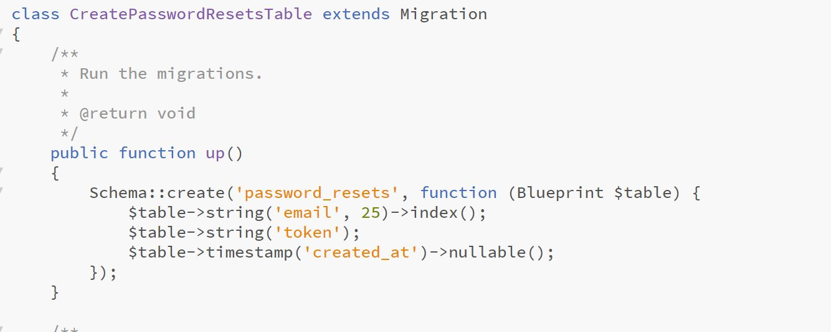

Slide 35
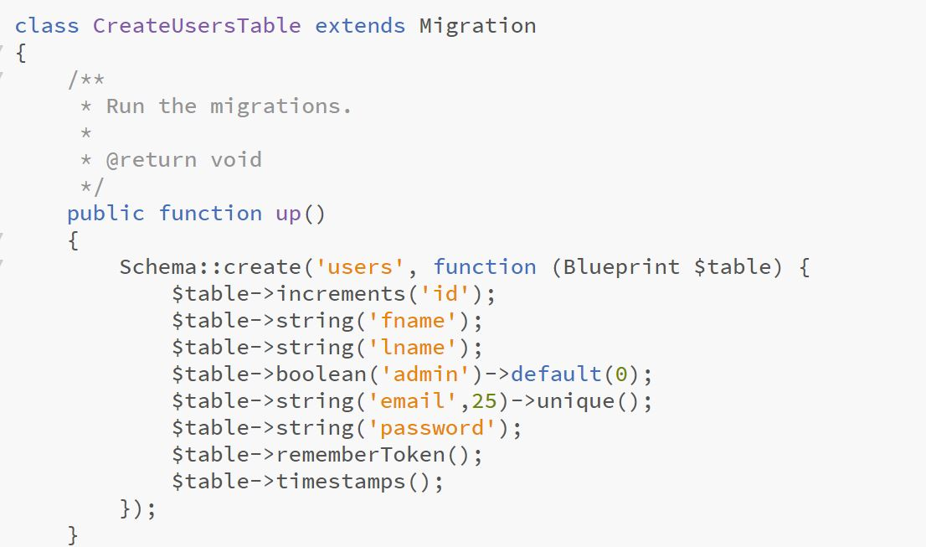

Slide 36
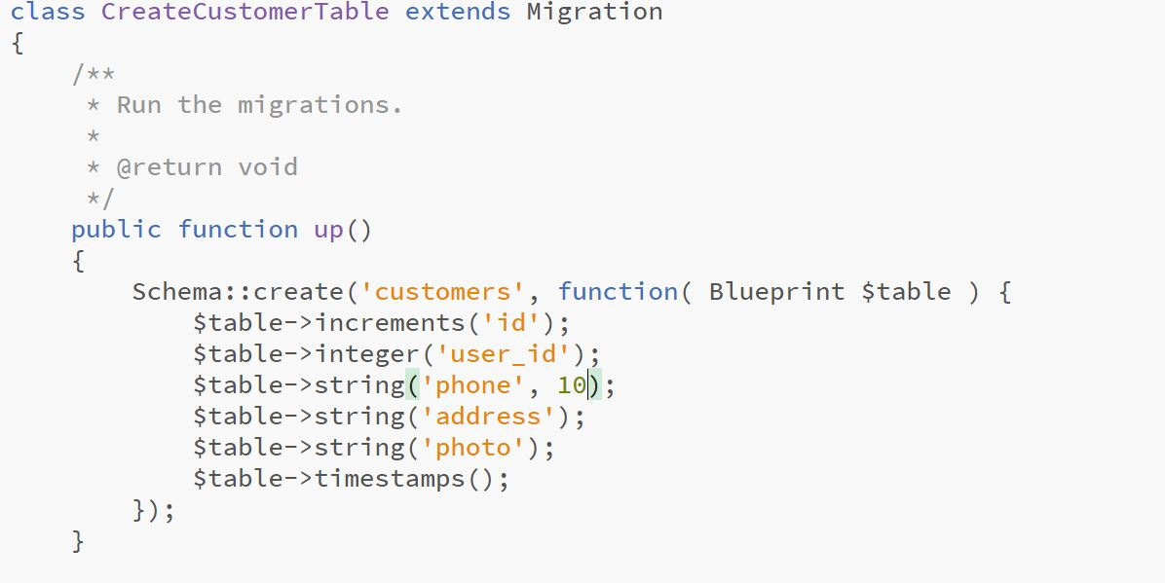

Slide 37
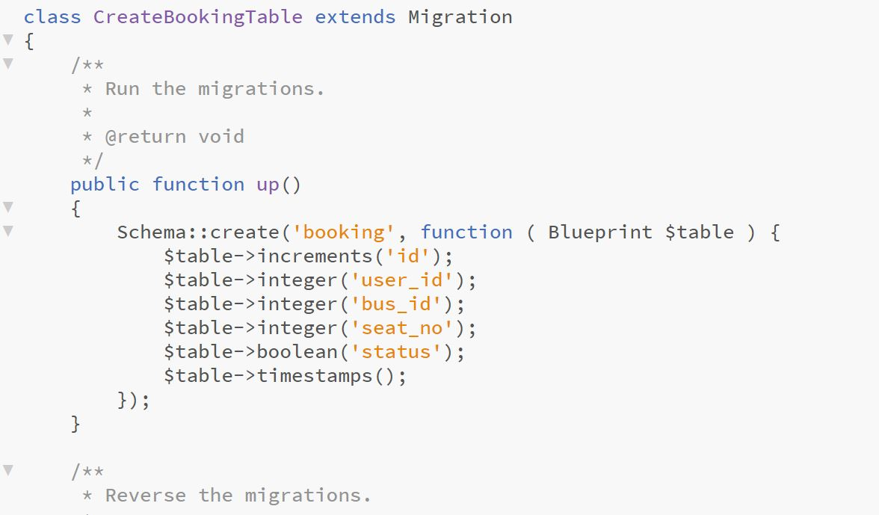

Slide 38
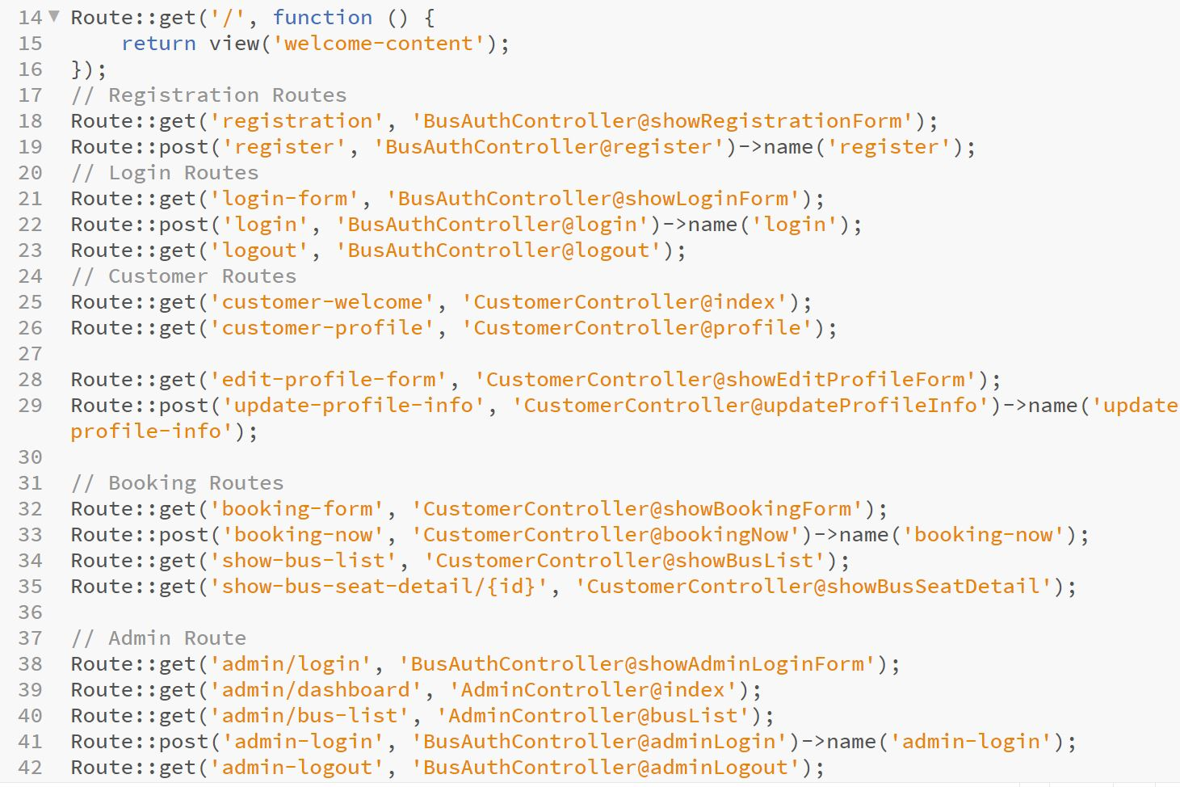

Slide 39
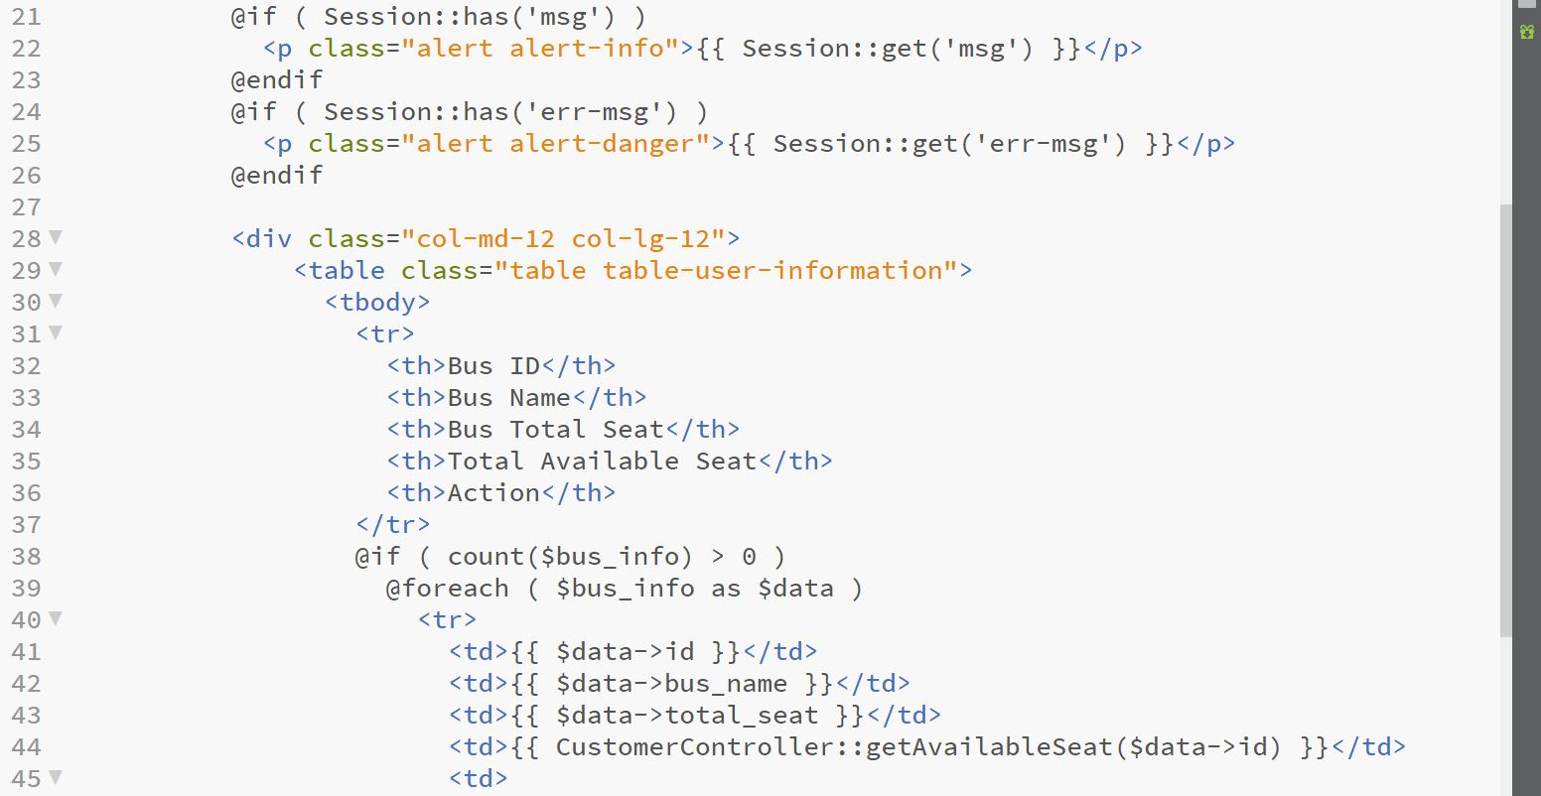

Slide 40
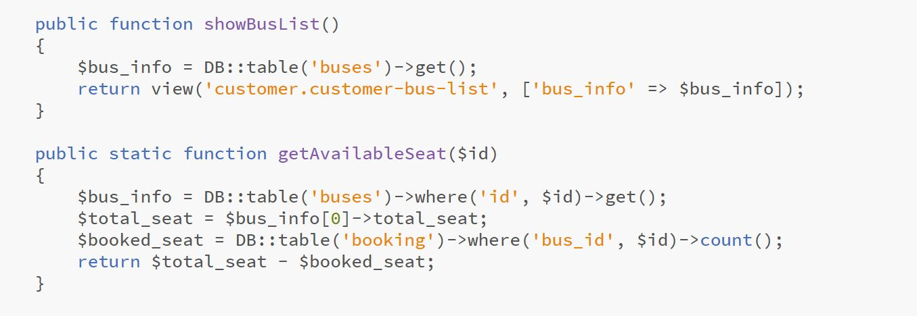

Slide 41
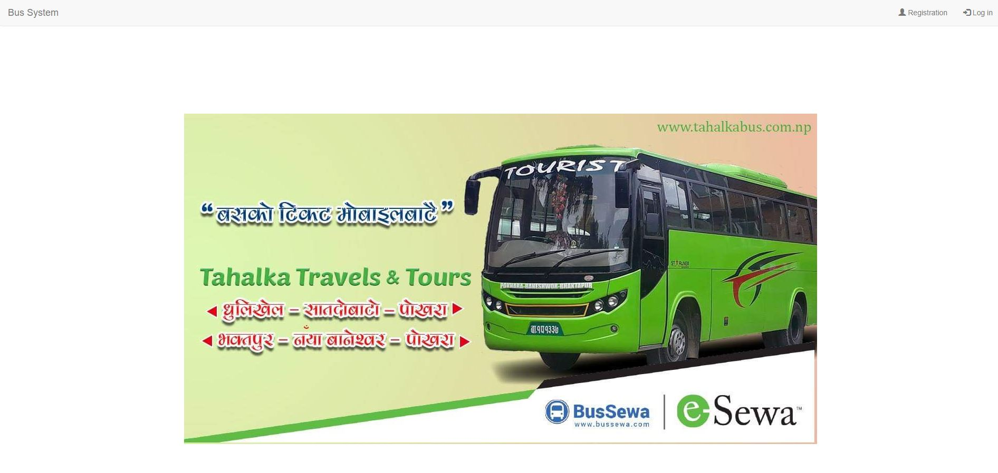

Slide 42
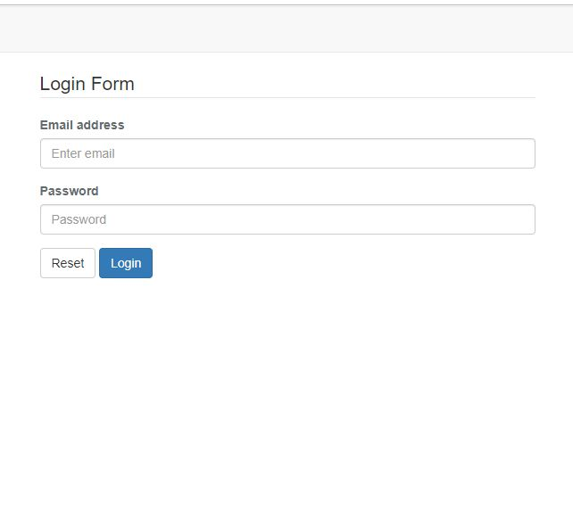

Slide 43
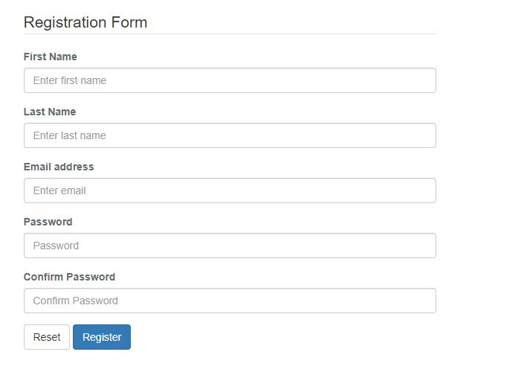

Slide 44
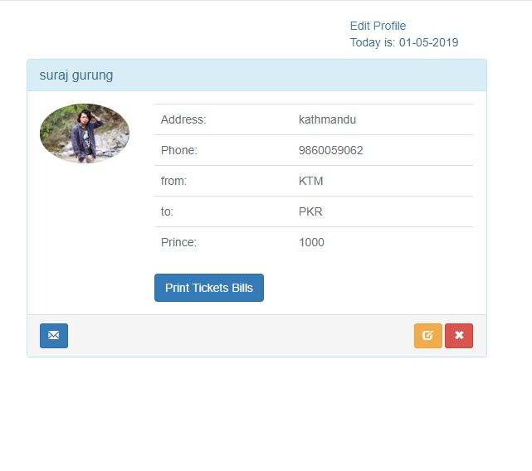

Slide 45
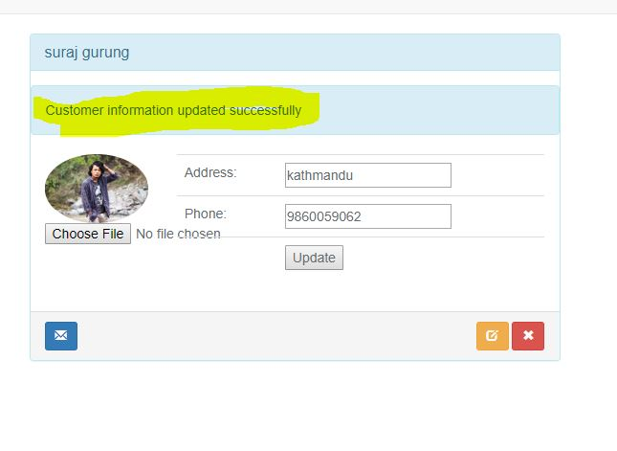

Slide 46
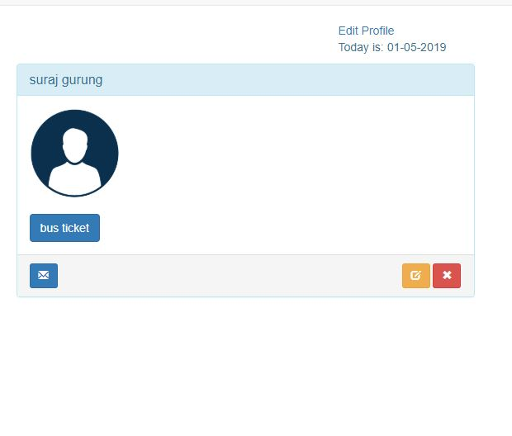

Slide 47
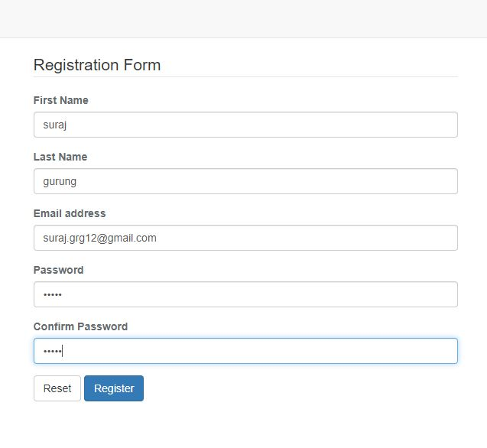

Slide 48
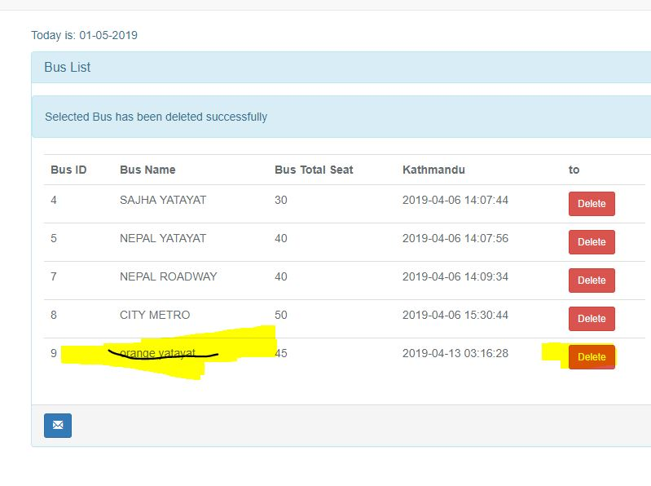

Slide 49
Test cases
Unit testing

Slide 50
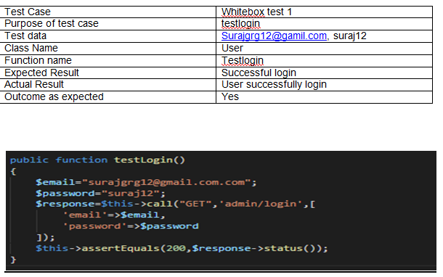

Slide 51
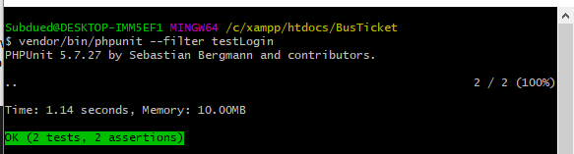

Slide 52
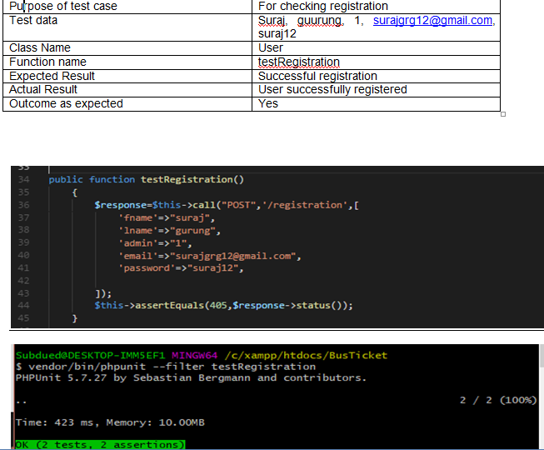

Slide 53
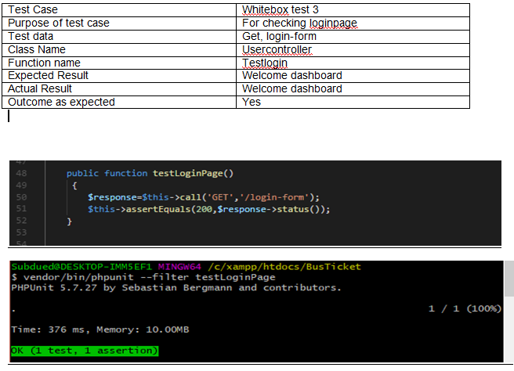

Slide 54
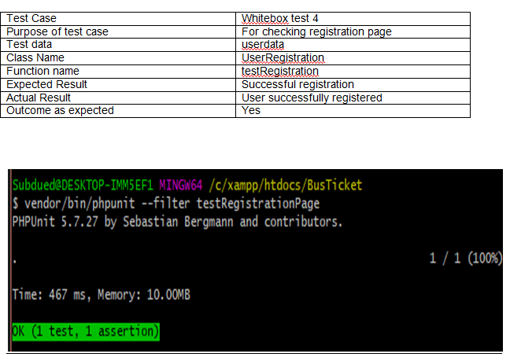

Slide 55
Black box testing
It is a method of software testing that examines the functionality of application
It did not hamper the internal structure or working of the system
It can be applied virtually to every level of software testing like unit testing, integration, etc

Slide 56
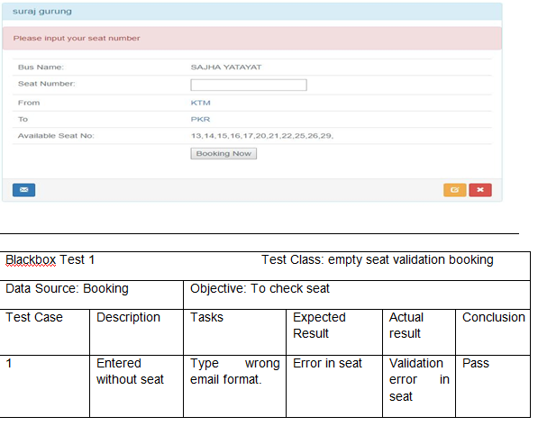

Slide 57
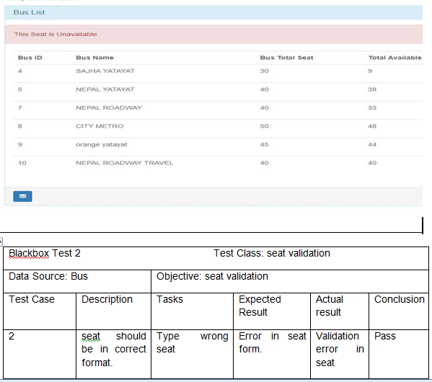

Slide 58
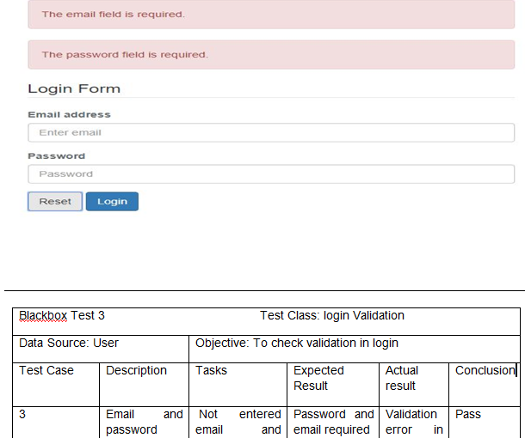

Slide 59
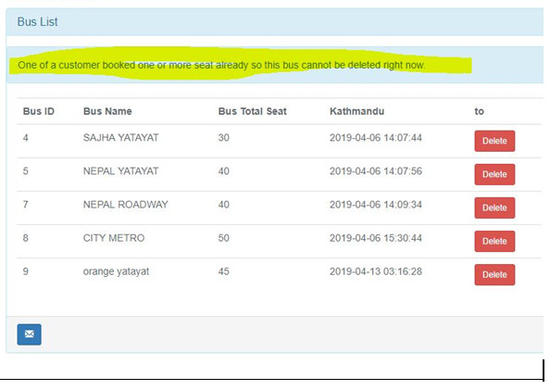

Slide 60
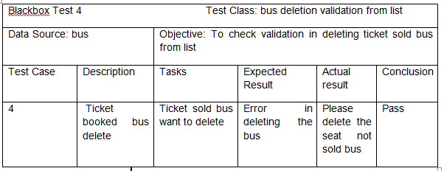

Slide 61
Future Work
payment system can be online
Domain registration can be done to access site from any browsers

Slide 62
Limitation
After all system was developed but unable to access the system from home/office
Payment mode Is available but can not be done yet from bank

Slide 63
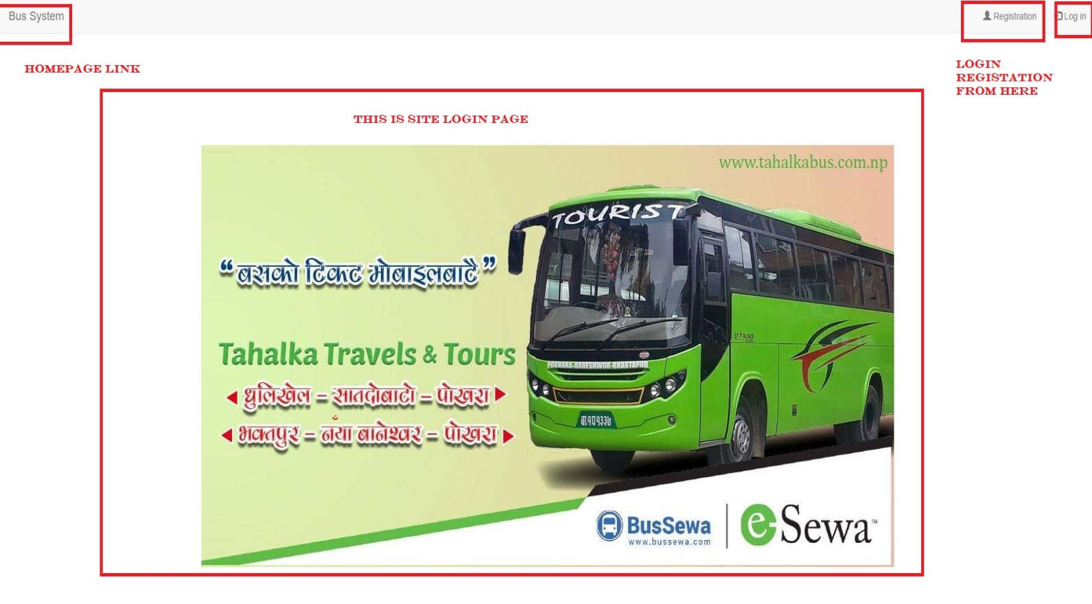
User manual

Slide 64
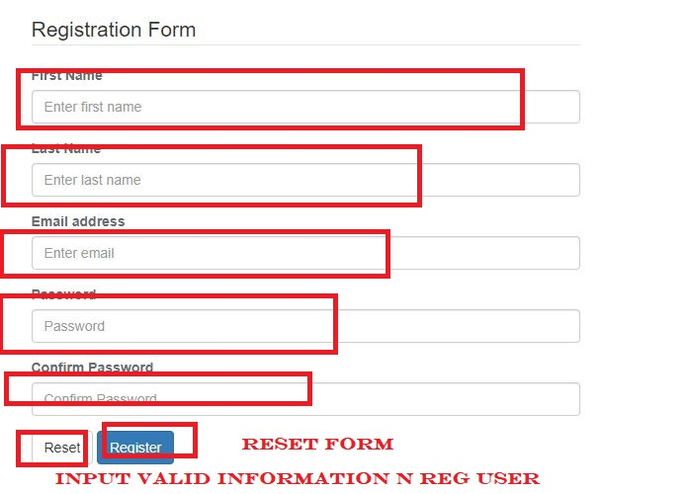

Slide 65
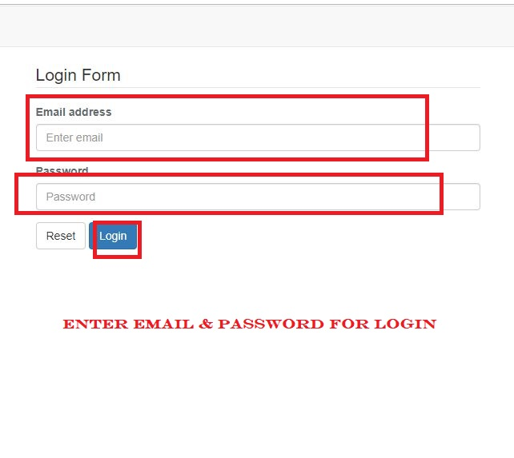

Slide 66
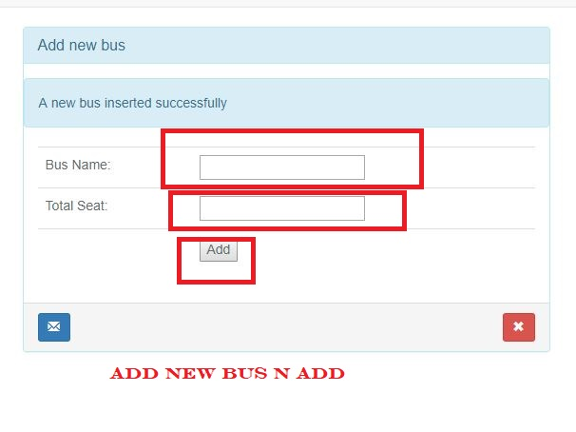

Slide 67
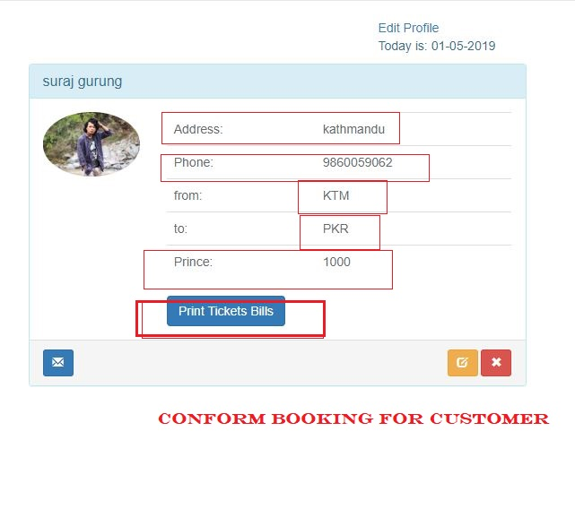

Slide 68
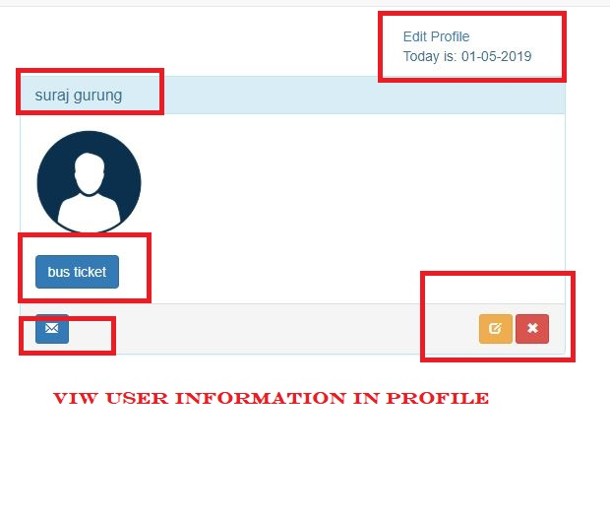

Slide 69
Conclusion
Hence the system is developed
It allows to register login and book ticket
Admin can add bus details and can edit profile
It is web based application

Slide 70
Reference

Slide 71
Any questions?

Slide 72
Thank you!!

